Slide 1

THE FRESH FARMERS

Slide 2
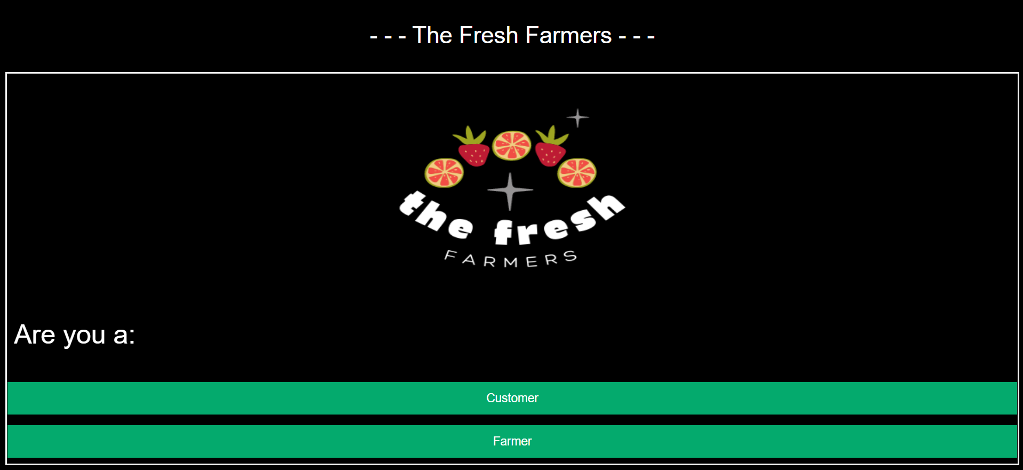
Our first page gives you option to choose whether you are a Customer or Farmer
If you are a Customer then click on customer button
If you are a Farmer then click on Farmer button

Slide 3
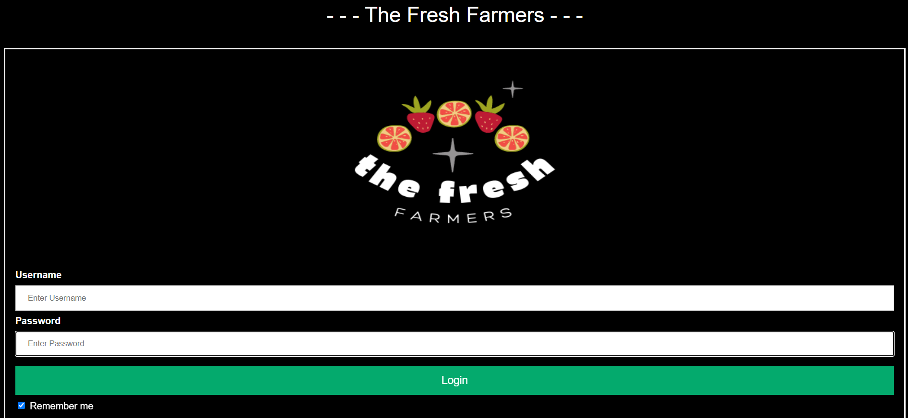
After selecting between Customer or Farmer, that will further leads you to our Login Page
Fill you details in given box (Username & Password)
If you are a Customer then you can’t login to Farmers page vice a versa

Slide 4
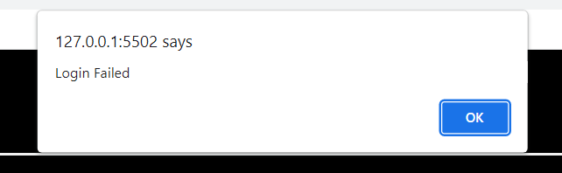
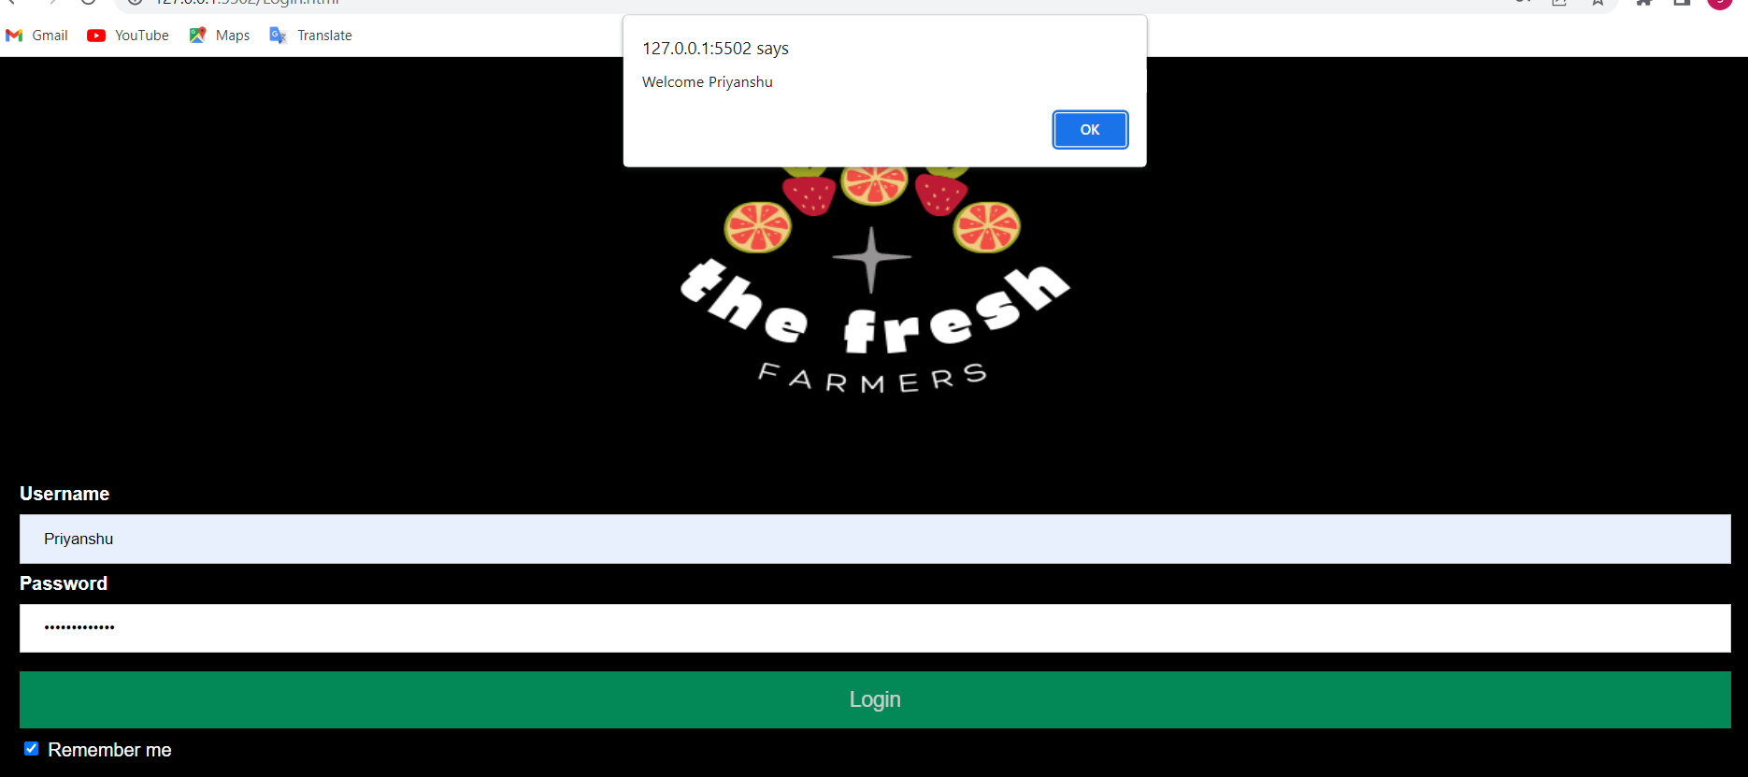
If you will fill wrong details then you will get Login failed alert
If you will fill correct details then you will get a welcome alert with your name

Slide 5
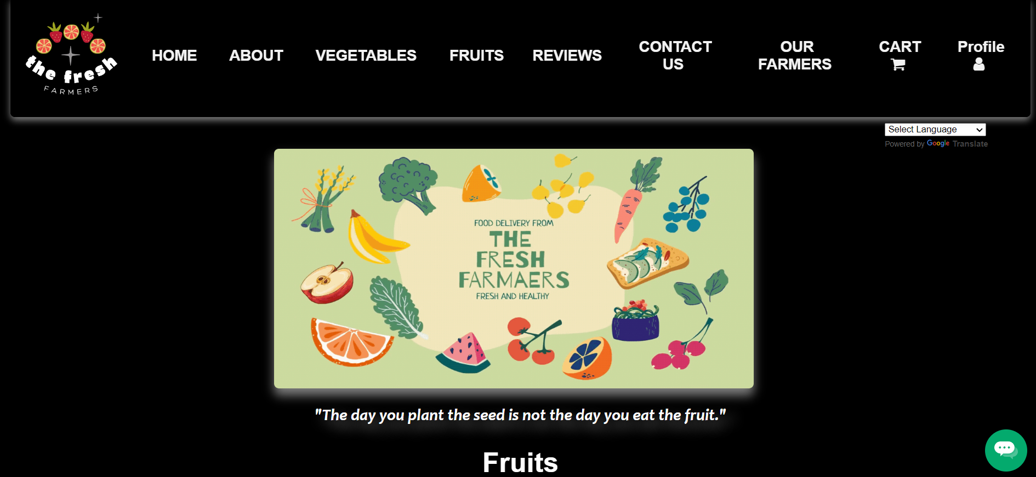
After successfully Login you will go to the homepage

Slide 6
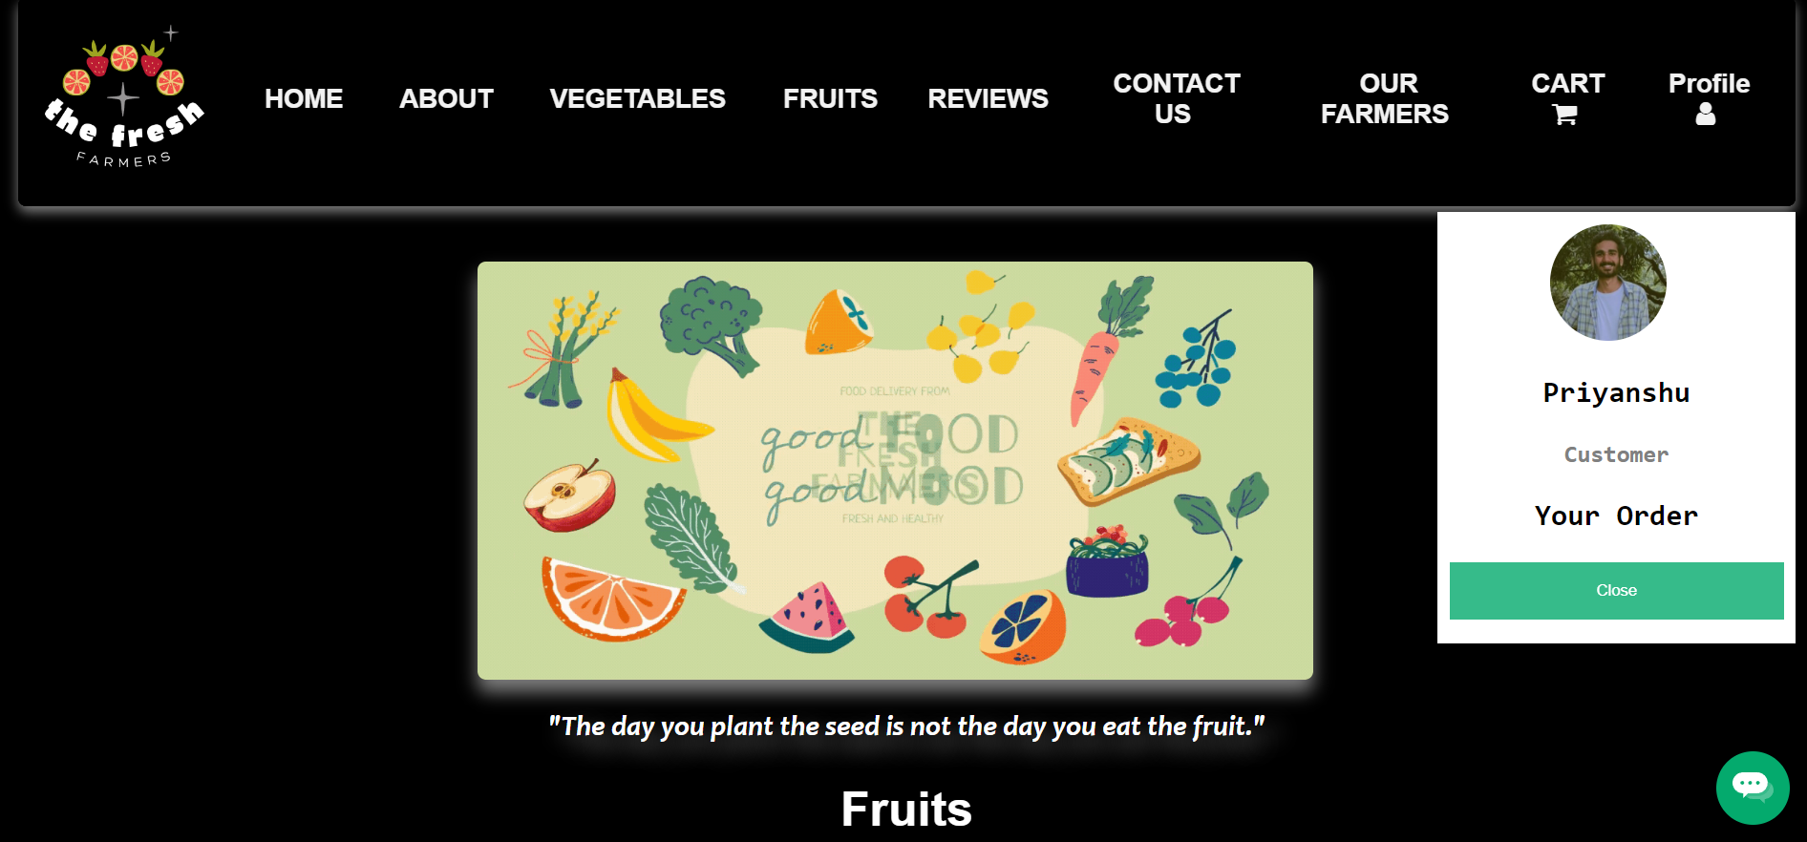
When you click on profile you will get your profile details

Slide 7
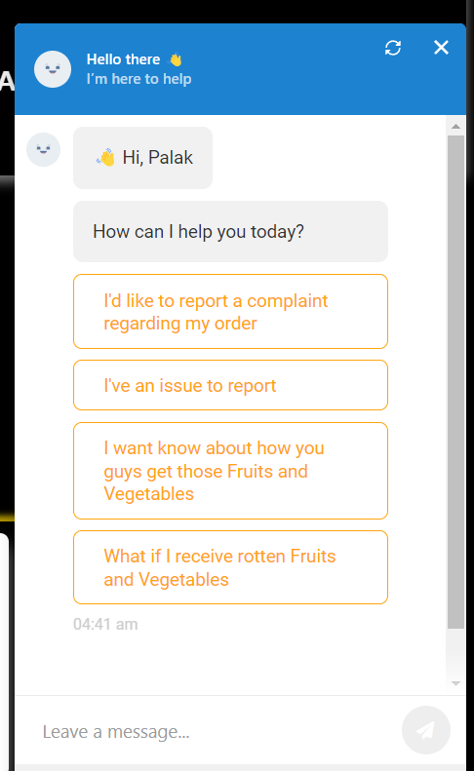
On the bottom right there is a chat box for customer to clear his/her query.
On click you will get a popup of the chat box

Slide 8
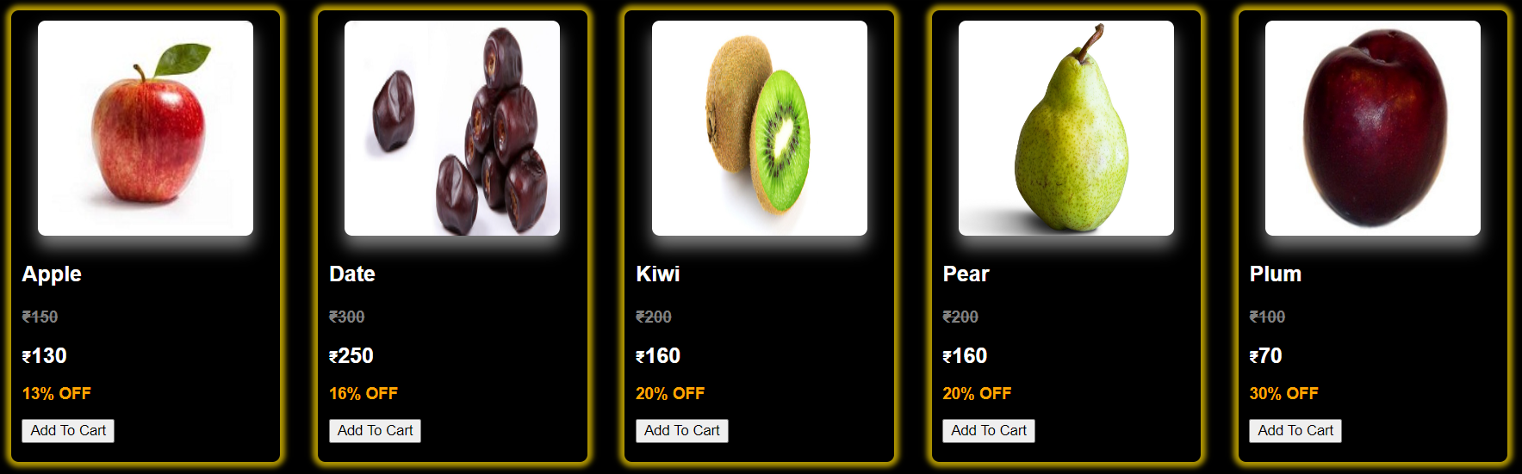
If you scroll down you can buy fruits and vegetables just add to cart the items you want
They will further be added to your cart

Slide 9
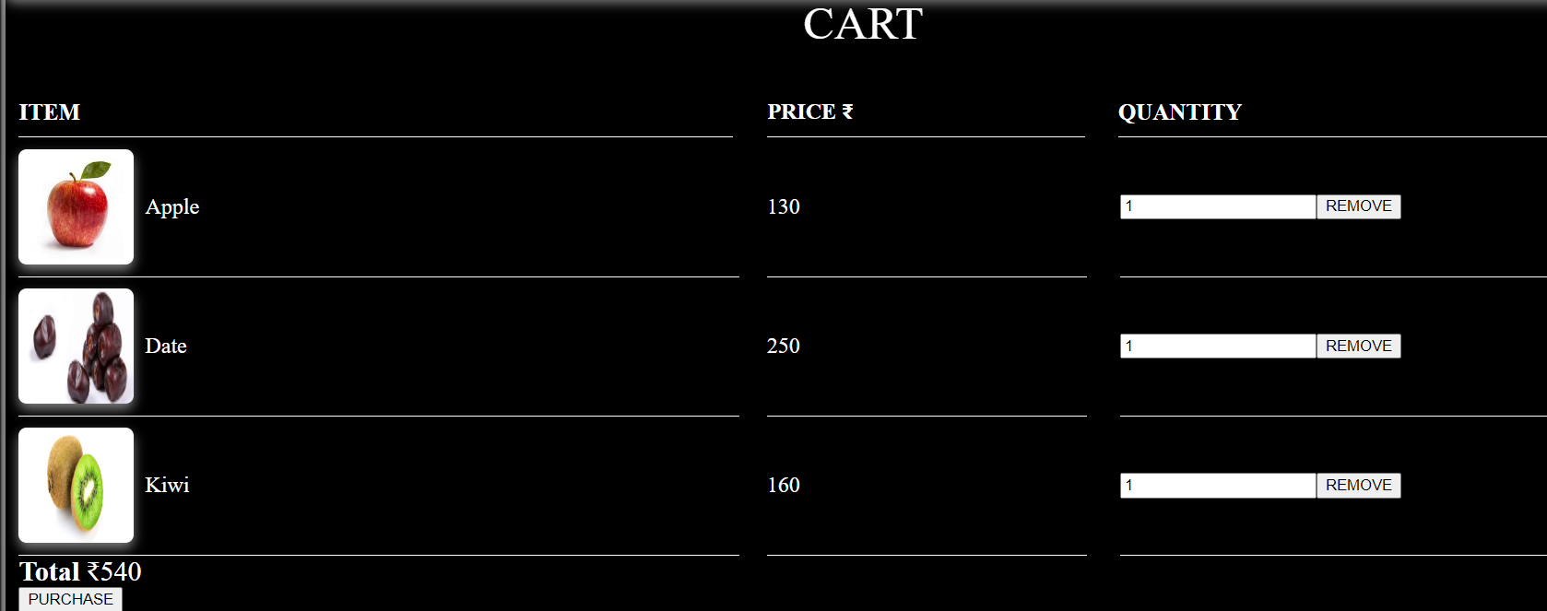
Here you can see you have your items which you have added to cart , you can check there individual price and total
You can even increase or decrease the quantity
If you click on Purchase button you will further processed to payment

Slide 10
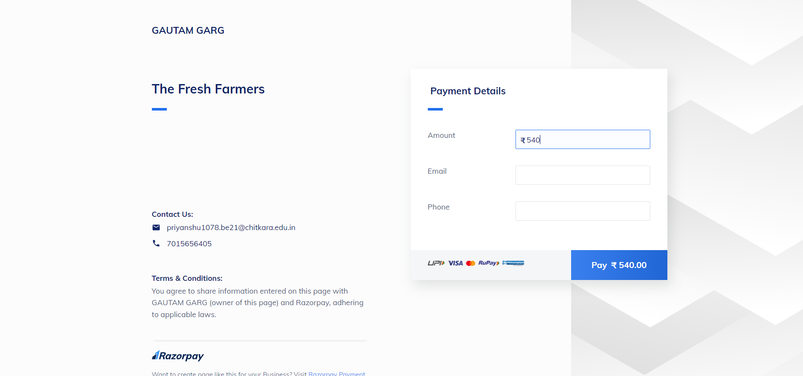
We don’t have a registered business so, we take help from razorpay for our payments
You can fill details and pay
After successful payment we will get all details about the order

Slide 11
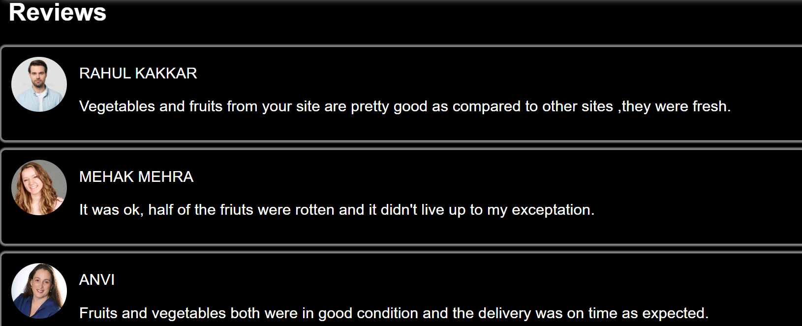
You can even check reviews of our website by just clicking on REVIEWS option available on navigation bar

Slide 12
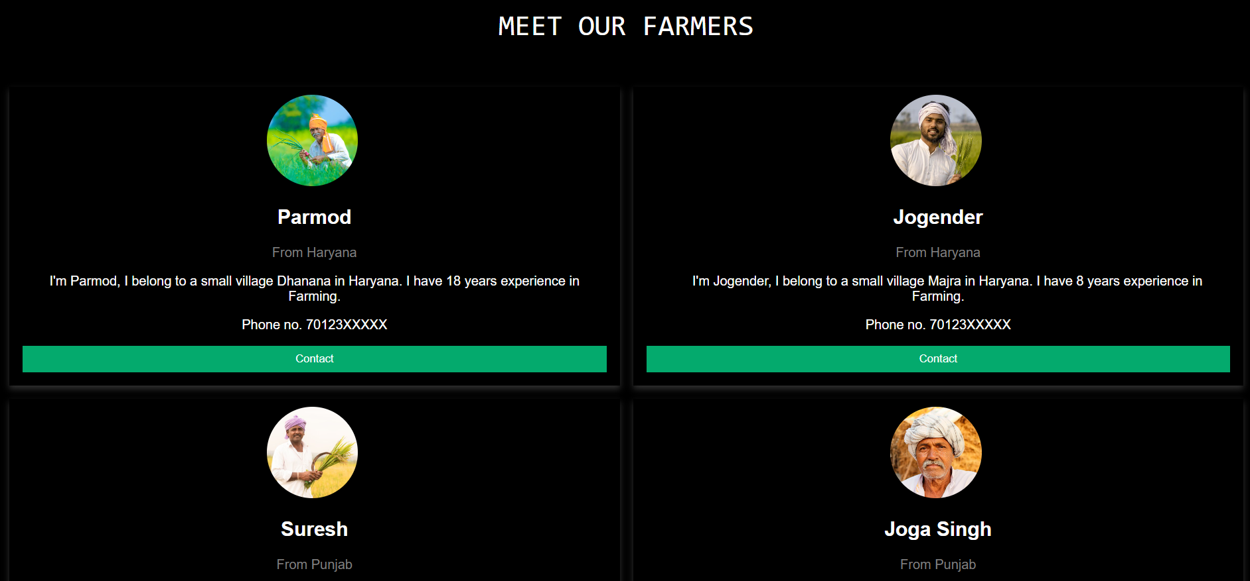
You can even check our top Farmers by just clicking on our farmers option in navigation bar

Slide 13
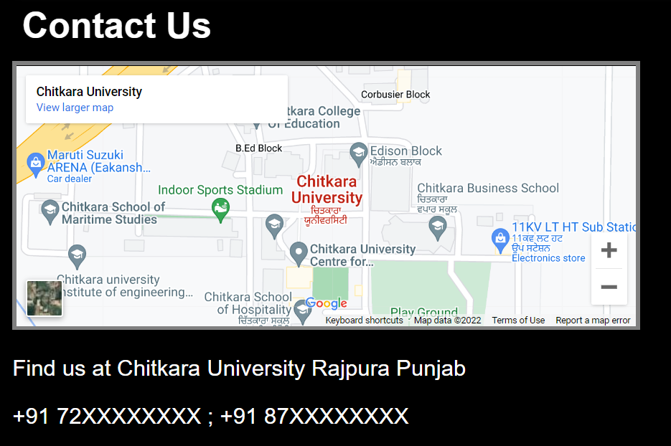
You can even contact us by phone calls or visiting us on our main office

Slide 14
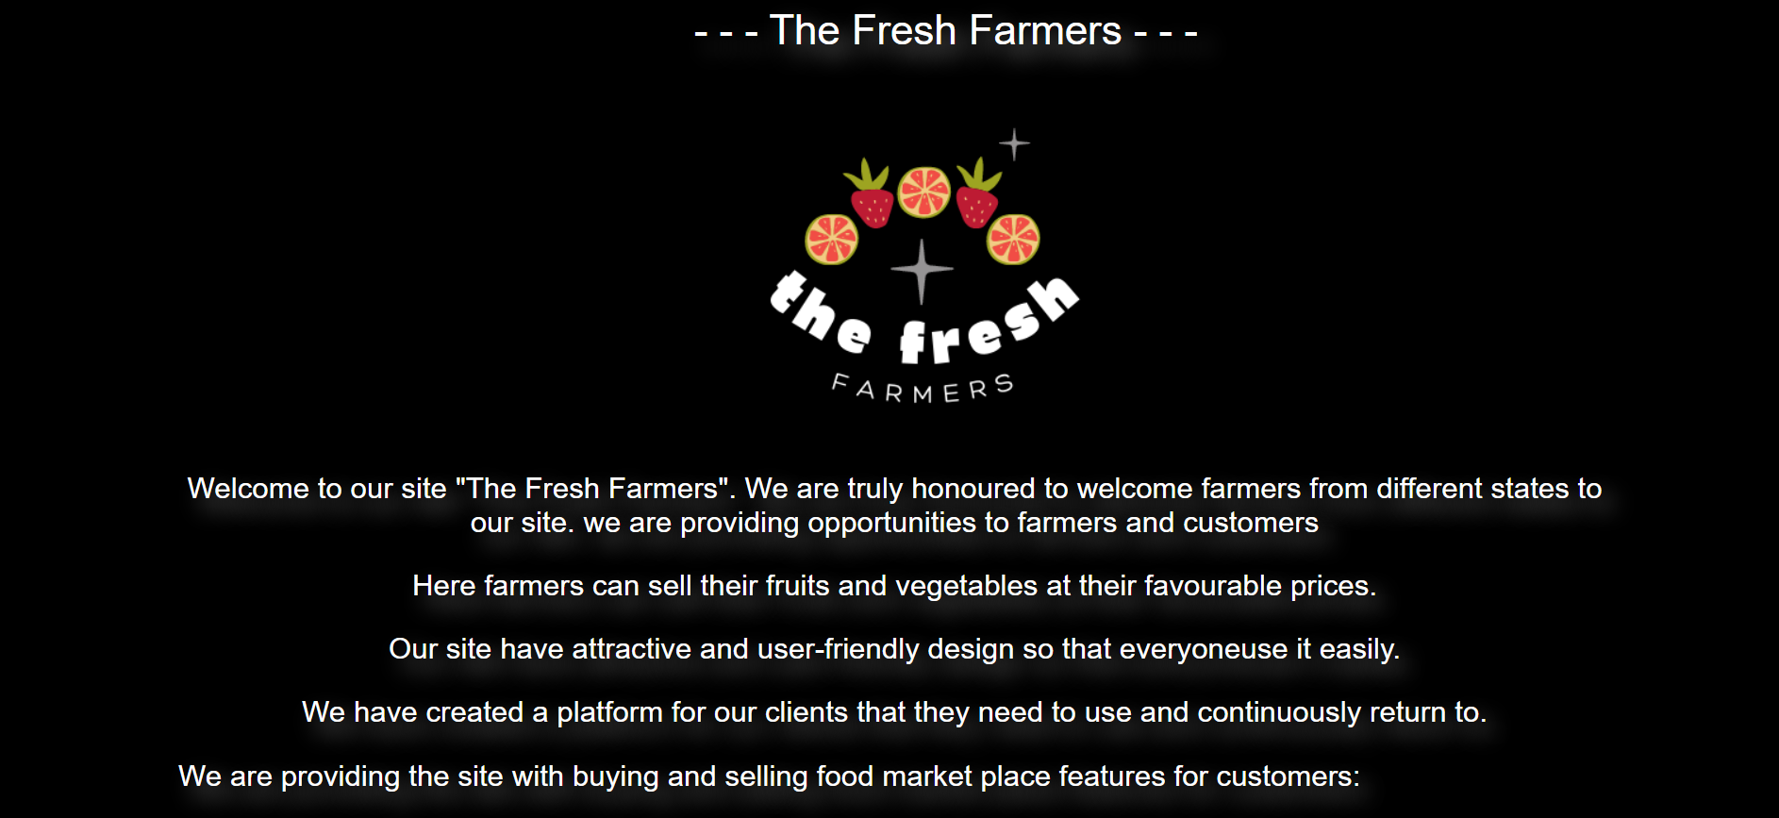
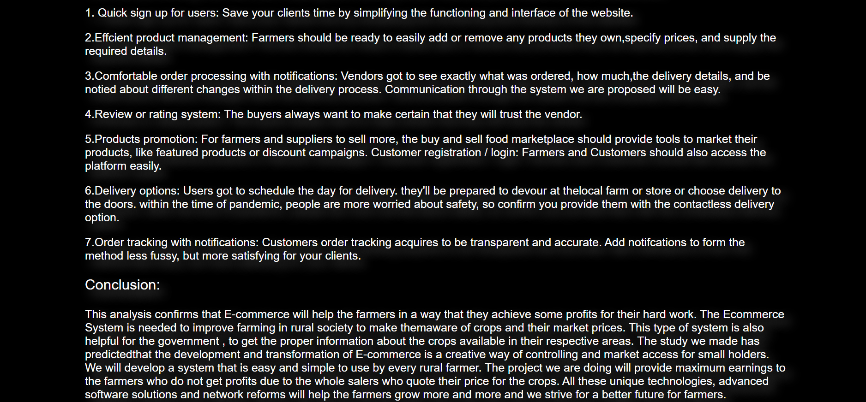
We even have our about page which tells you why we are special than others

Slide 15
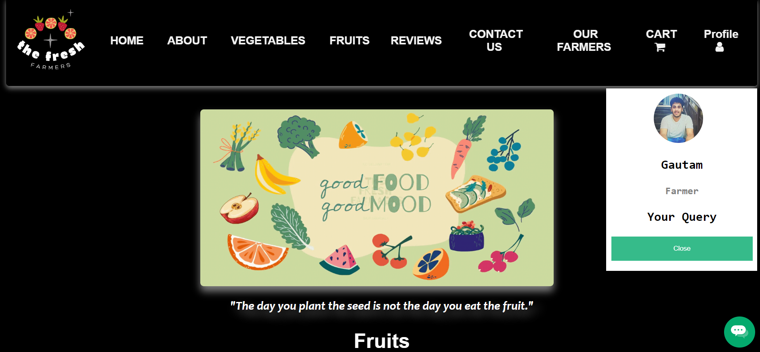
Now what if you are a Farmer
If you Login your details properly you will further lead to homepage for farmers

Slide 16
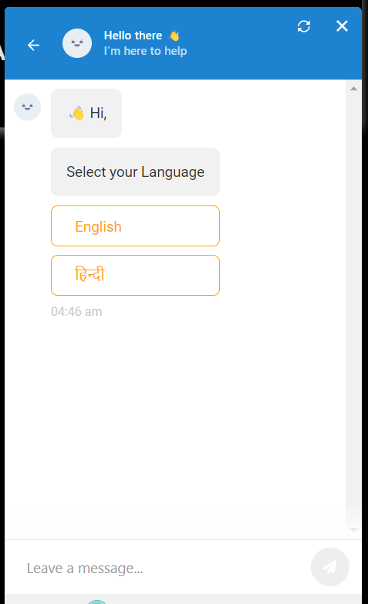
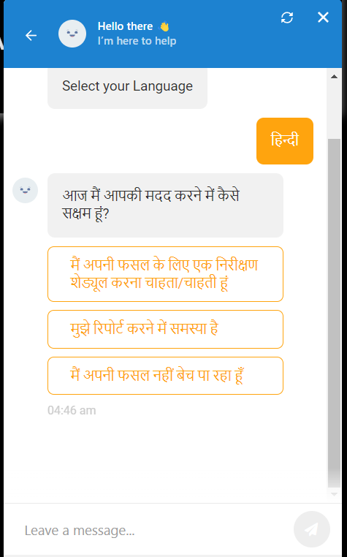
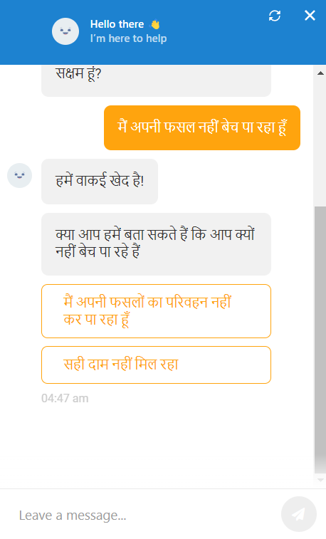
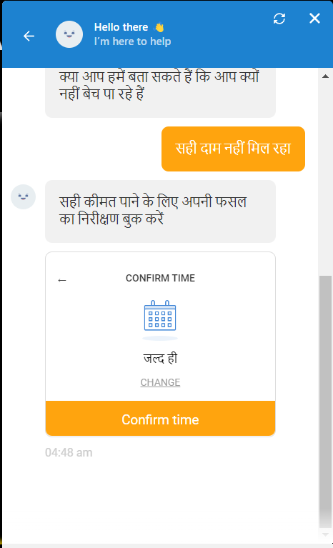
Now the Chat Box work totally different now it will solve the query of farmers
For easy use we have provided Hindi language for farmers to interact with our Chat Box

Slide 17
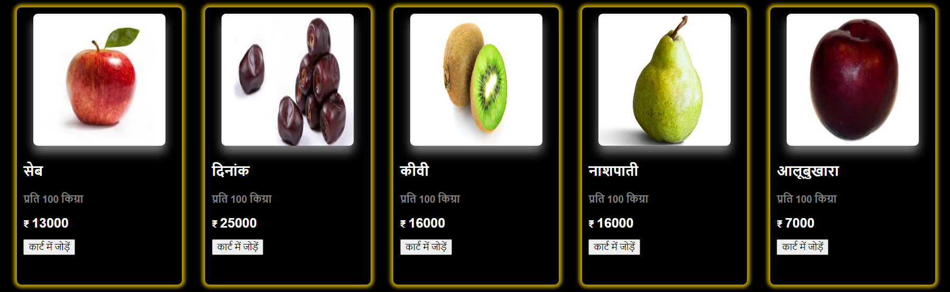
By selecting language from top right corner they can even change the language of whole site
Farmer can just add the crops he want to sell to the cart and can further request money from us

Slide 18
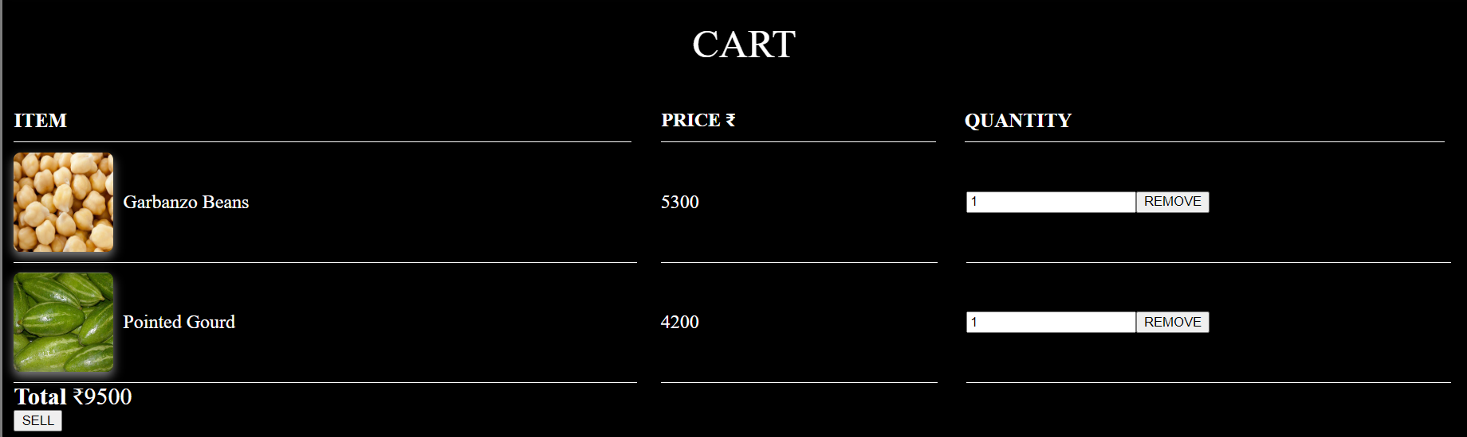
Cart work smoothly farmer and add or remove the items

